Slide 1
ANZ Bank analysis and segmentation
J Shiva Keerthan

Slide 2
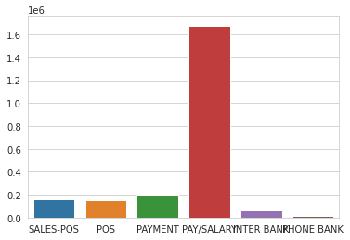
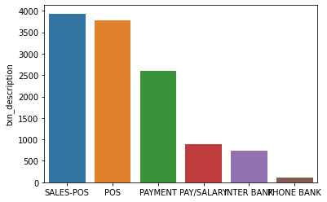
Data exploration
- Most of transactions are done at lat & long - 153.41 -27.95 and second highest at - 151.23 -33.94
- Most of transactions are linked to SALES-POS and POS (3934,3783)
-Though most of transactions are for POS, the more money transacted is through PAY/SALARY (1600000)(1.6 Million AUD)

Slide 3
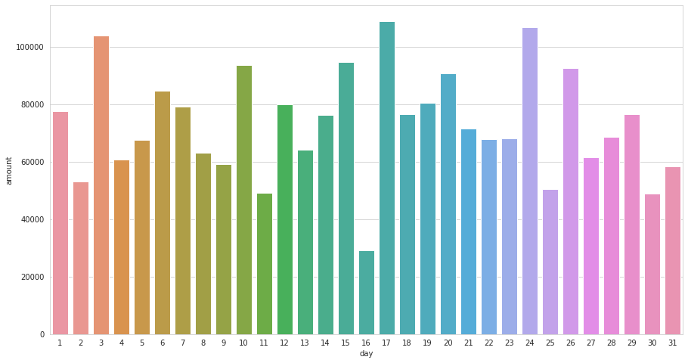
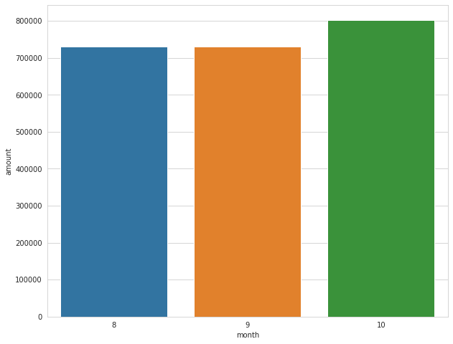
DATA EXPLORATION
- There are 3 instances where 100,000 AUD amount was transacted which were on 3rd ,17th and 24th.
-Highest transaction was done in 10th month for 800,000 AUD

Slide 4
DATA EXPLORATION
Men have high amount transaction rate than women and so have the highest average. average(205 per trans AUD). sum(1292961 AUD).
In all categories Male are showing the domination in transaction amount
Customer who have done Highest transaction in past 3 months - 'Diana’
- Highest extraction was carried out on 03-09-2018
- The most amount was spent using credit card and male have spent the highest(on credit - 972920) (703656 otherwise).
- Age 15-20 Females are spending the most compared to males in the same age group. In all other age groups males have dominated the expenditure.
- Age (20-30) Females are most spent age group in Females.-(337,548) and is the same with males.-(501,837)

Slide 5
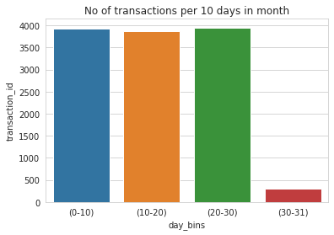
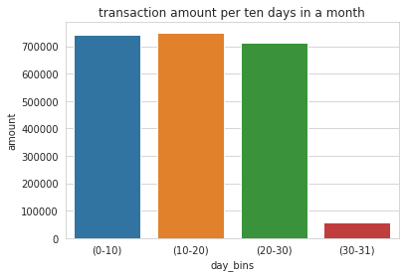
DATA EXPLORATION
- Average transaction amount is 188 AUD
- There are 4014 transactions on average per month
- More amount is transacted in mid 10 days of the month
- The most transactions occured in last 10 days(20-31)
of the month
- on 16th and 31 less significant transactions took place
(pay checks)
NSW state has made highest transactions with VIC.
The Least number transactions are with TAS.
Though we donot have many datapoints
(lots of missing points)

Slide 6
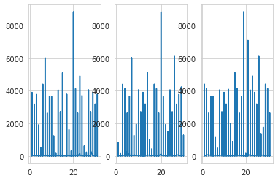
DATA EXPLORATION
The transaction have been increasing from month
8 to 10. The highest recorded transactions are on
month 10 (october)
19th -20th of every month the amount
transacted is almost the same about 9000 AUD
More transactions have been donw in
Melbourne and Sydney

